Slide 1
English Program Office of Academic Affairs
Prof. Patricia Nieves Sánchez
Director of Operations

Slide 2
Public Policy Notification
The Puerto Rico Department of Education does not discriminate in way based on age, race, color, sex, birth, veteran status, political or religious ideology, origin or social condition, sexual orientation or gender identity, disability or physical handicap, or mind; or being a victim of domestic violence, sexual assault, or stalking.

Slide 3
Disclaimer
For legal purposes in relation to the Civil Right Act of 1964, the use of the terms student, teacher, principal, facilitator, and any other that may refer to both genders includes both male and female.

Slide 4
Objectives
1. The main purpose of the revision
2. English Program cornerstones
3. English Program standards and expectations significant changes

Slide 5
Objectives
4. Transversal Themes upgrade
5. Revised Curriculum Maps tools
6. English Program Circular Letter

Slide 6
Foundations of the Academic Services Curriculum Review Project

Slide 7
NEW CURRICULUM IN THE AREA OF ACADEMIC SERVICES
CRITICAL THINKING
RELEVANCE OF STUDY PROGRAM (THE LAW 85-2018)
CREATIVE THINKING
SUSTAINABLE DEVELOPMENT GOALS
ATTITUDES FOR ACADEMIC SUCCESS
CORE COMPETENCIES FROM FINLAND
EQUITY AND RESPECT FOR ALL HUMAN BEINGS
COMPETENCIES OF THE 21ST CENTURY

Slide 8
Guiding Principles

Slide 9
The Guiding Principles
Analysis of the standarized test results and grades distributions.
Consultations with teachers, professor universities, members from PRTESOL and students.
Review of literature and educational standards from jurisdictions and countries.
Recommendations from PRDE’s Technical Advisory Committee (TAC)

Slide 10
Relevance of the curriculum
Homogenize document formats
Ensure the rigor of each grade and subject
Comply with the Peer Review from the Federal Department of Education

Slide 11
English Program Focus during the Curriculum Revision Process

Slide 12
English Program
Focus áreas for 2022-2023
Develop the five basic reading skills in the English language (phonological awareness, phonics, vocabulary, fluency, and comprehension).
Emphasize instructional strategies in teaching foundational skills at all grade level.

Slide 13
English Program Focus
English teachers must provide experiences where the students can listen, communicate, ask questions, and engage inside and outside the classroom.
Provide ample opportunities to use technology in all English language skills.

Slide 14
English Program Standards and Expectations Significant Changes

Slide 15
English Program Standards
Grade | Standards 2014 | Standards 2022
K-8 | Listening Speaking Reading Writing Language | Listening/ Speaking Reading Writing Language Foundational Skills
9 -12 | Listening Speaking Reading Writing Language | Listening/ Speaking Reading Writing Language

Slide 16
Revision and Essential Changes in the English Program Curriculum
We incorporated listening into the speaking standard.
New indicators and sub-indicators were formed in the new standard Foundational Skills (phonological awareness, phonics, high-frequency words, the alphabet, the concept of print and fluency).
We highlighted the writing process skills and defined the writing structure of paragraphs and essays through all grade levels.

Slide 17
Revision and Essential Changes in the English Program Curriculum
The indicators and sub-indicators were reorganized in a logical sequence by themes and grades.
All grade-level indicators and sub-indicators integrate technology as tool for students to produce, publish, interact, and collaborate with others.

Slide 18
The New Transversal Themes
The Teaching-Learning Planning Process

Slide 19
The New Transversal Themes
Transversal themes are described by UNESCO (2013) as critical and innovative thinking, interpersonal and intrapersonal skills, global citizenship, and physical and psychological health. In addition, many terms are interchangeably used to describe cross-curricular abilities across different countries as transversal skills, key competences, 21st century skills, and so on.

Slide 20
The New Transversal Themes
The Department of Education states the student must be college and career ready and have the aptitudes of a member of a diverse community and ethics while emphasizing the importance of transversal themes in the process of learning.

Slide 21
New Cross-Cutting Curricular Themes
2003 | 2022
Cultural identity Civic and ethical education Peace education Environmental education Education for work Education and technology | Equity and respect among all human beings Cultural identity and interculturality Environmental and ecological awareness education Entrepreneurship and innovation Health promotion Information and communication technologies

Slide 22
The Revised Curriculum Maps
The Teaching-Learning Planning Process

Slide 23
Purpose of Curriculum Maps
To provide the guidelines for standards- based instruction
To organize the standards into teachable units of instruction

Slide 24
Revised Curriculum Map’s Tools
Pacing Calenders
Curriculum Alignment tool
Content Maps
Attachments
Supplemental Materials

Slide 25
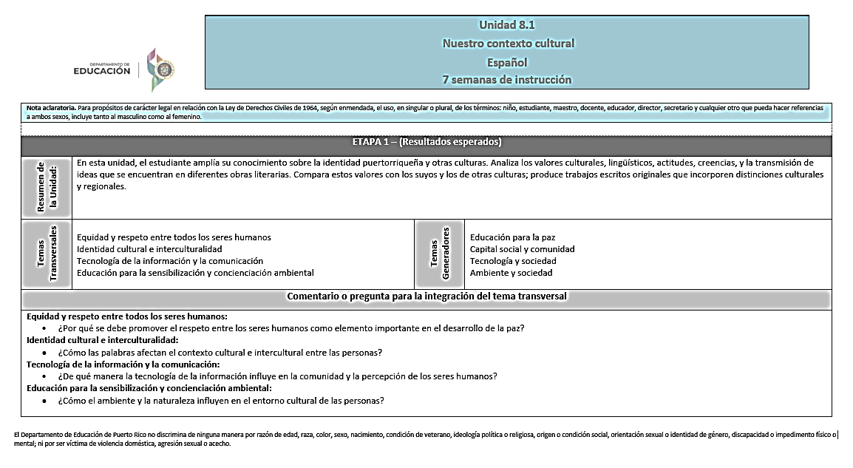

Slide 26
English Program Circular Letter
Significant Changes
Emphasized Approaches:
The Structural Literacy Approach is explicit and systematic teaching that focuses in developing the foundational skills
The Process-Based Writing Approach focuses on developing activities while producing of a written text.
The Communicative Approach is aimed at developing the learner’s competence to communicate in the target language (communicative competence), with an enhanced focus on real-life situations.

Slide 27
The Range of Expected Achievements of these Changes
The Teaching-Learning Planning Process

Slide 28
The Range of Expected Achievements of these Changes
1. To improve and strengthen students’ speaking and listening skills of the English language in all grades.
2. Develop in students a strong foundation in the use of oral language to build vocabulary and reading.
3. Increase engagement in learning English in students from all grade levels using technology tools.

Slide 29
The Range of Expected Achievements of these Changes
4. Improve teacher planning process by focusing on the student’s individual learning needs.
5. Develop and improve writing skills in all grade levels.
6. To enhance the opportunity to develop English langauge proficiency in students.

Slide 30
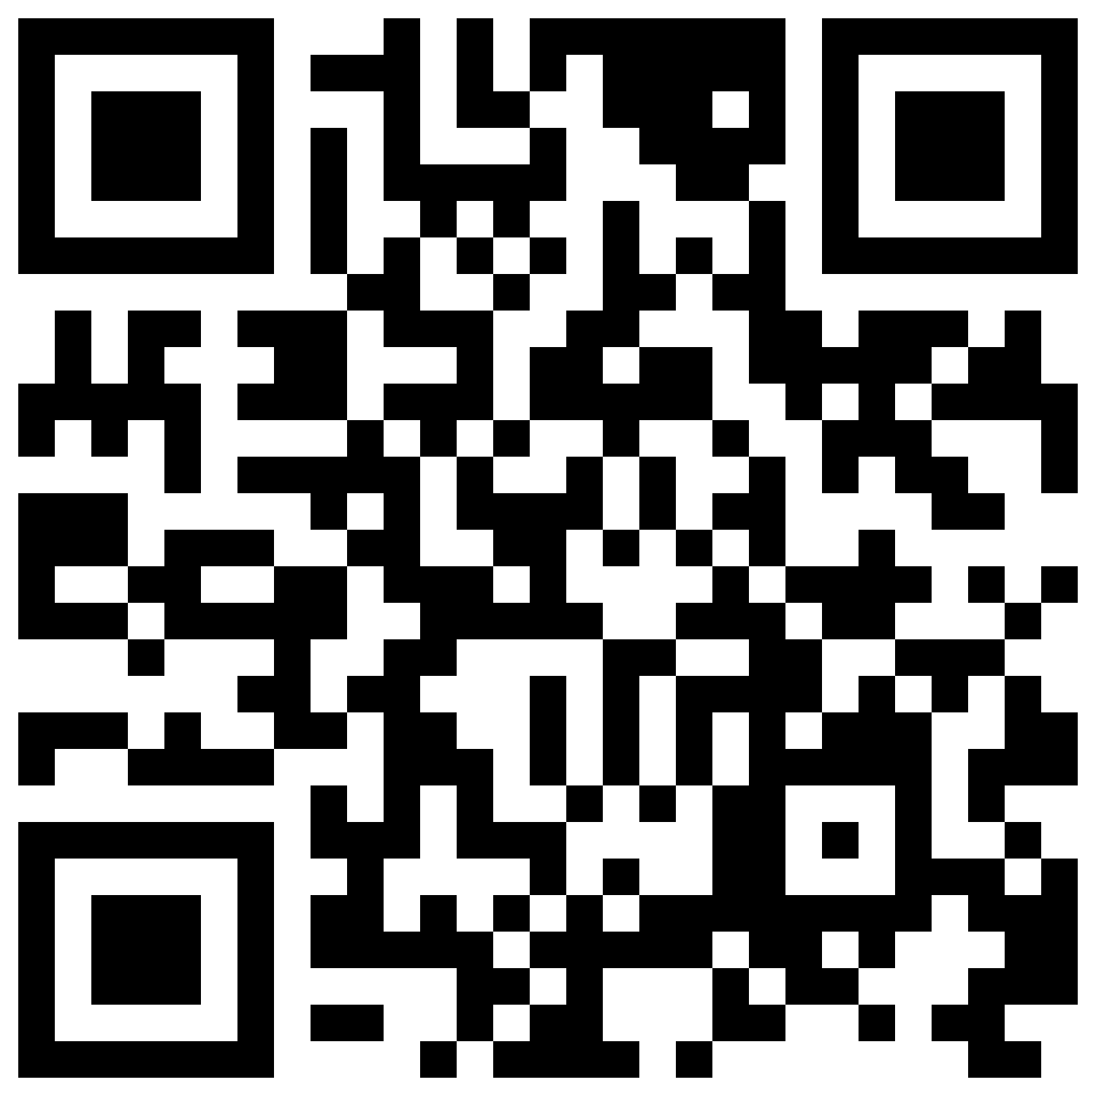
Leave your feedback on the program curriculum review by scanning the QR code.

Slide 31
Patricia Nieves Sánchez English Program Supervisor of Operations 787-773-3547 nievessp@de.pr.gov

Slide 32
Thank you!!!

